Slide 1
Chapter 6
Digital Design and Computer Architecture, 2nd Edition
David Money Harris and Sarah L. Harris

Slide 2
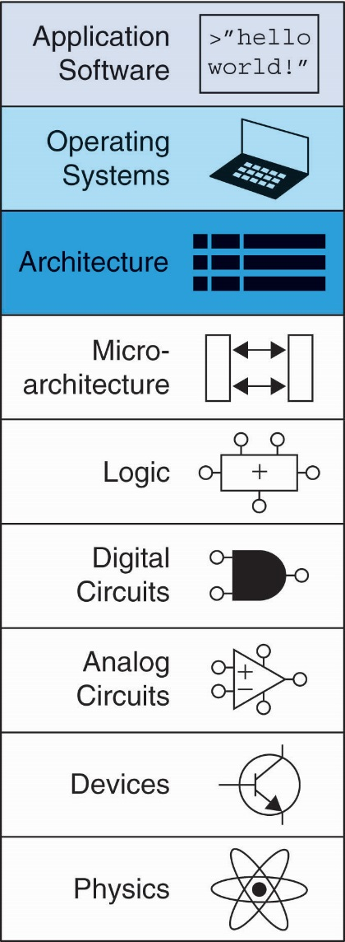
Chapter 6 :: Topics
Introduction
Assembly Language
Machine Language
Programming
Addressing Modes
Lights, Camera, Action: Compiling, Assembling, & Loading
Odds and Ends

Slide 3
Introduction
Jumping up a few levels of abstraction
Architecture: programmer’s view of computer
Defined by instructions & operand locations
Microarchitecture: how to implement an architecture in hardware (covered in Chapter 7)

Slide 4
Assembly Language
Instructions: commands in a computer’s language
Assembly language: human-readable format of instructions
Machine language: computer-readable format (1’s and 0’s)
MIPS architecture:
Developed by John Hennessy and his colleagues at Stanford and in the 1980’s.
Used in many commercial systems, including Silicon Graphics, Nintendo, and Cisco
Once you’ve learned one architecture, it’s easy to learn others

Slide 5

John Hennessy
President of Stanford University
Professor of Electrical Engineering and Computer Science at Stanford since 1977
Coinvented the Reduced Instruction Set Computer (RISC) with David Patterson
Developed the MIPS architecture at Stanford in 1984 and cofounded MIPS Computer Systems
As of 2004, over 300 million MIPS microprocessors have been sold

Slide 6
Architecture Design Principles
Underlying design principles, as articulated by Hennessy and Patterson:
Simplicity favors regularity
Make the common case fast
Smaller is faster
Good design demands good compromises

Slide 7
Instructions: Addition
add: mnemonic indicates operation to perform
b, c: source operands (on which the operation is performed)
a: destination operand (to which the result is written)
C Code
a = b + c;
MIPS assembly code
add a, b, c

Slide 8
Instructions: Subtraction
Similar to addition - only mnemonic changes
sub: mnemonic
b, c: source operands
a: destination operand
C Code
a = b - c;
MIPS assembly code
sub a, b, c

Slide 9
Design Principle 1
Simplicity favors regularity
Consistent instruction format
Same number of operands (two sources and one destination)
easier to encode and handle in hardware

Slide 10
Multiple Instructions
More complex code is handled by multiple MIPS instructions.
C Code
a = b + c - d;
MIPS assembly code
add t, b, c # t = b + c
sub a, t, d # a = t - d

Slide 11
Design Principle 2
Make the common case fast
MIPS includes only simple, commonly used instructions
Hardware to decode and execute instructions can be simple, small, and fast
More complex instructions (that are less common) performed using multiple simple instructions
MIPS is a reduced instruction set computer (RISC), with a small number of simple instructions
Other architectures, such as Intel’s x86, are complex instruction set computers (CISC)

Slide 12
Operands
Operand location: physical location in computer
Registers
Memory
Constants (also called immediates)

Slide 13
Operands: Registers
MIPS has 32 32-bit registers
Registers are faster than memory
MIPS called “32-bit architecture” because it operates on 32-bit data

Slide 14
Design Principle 3
Smaller is Faster
MIPS includes only a small number of registers

Slide 15
MIPS Register Set
Name | Register Number | Usage
$0 | 0 | the constant value 0
$at | 1 | assembler temporary
$v0-$v1 | 2-3 | Function return values
$a0-$a3 | 4-7 | Function arguments
$t0-$t7 | 8-15 | temporaries
$s0-$s7 | 16-23 | saved variables
$t8-$t9 | 24-25 | more temporaries
$k0-$k1 | 26-27 | OS temporaries
$gp | 28 | global pointer
$sp | 29 | stack pointer
$fp | 30 | frame pointer
$ra | 31 | Function return address

Slide 16
Operands: Registers
Registers:
$ before name
Example: $0, “register zero”, “dollar zero”
Registers used for specific purposes:
$0 always holds the constant value 0.
the saved registers, $s0-$s7, used to hold variables
the temporary registers, $t0 - $t9, used to hold intermediate values during a larger computation
Discuss others later

Slide 17
Instructions with Registers
Revisit add instruction
C Code
a = b + c
MIPS assembly code
# $s0 = a, $s1 = b, $s2 = c
add $s0, $s1, $s2

Slide 18
Operands: Memory
Too much data to fit in only 32 registers
Store more data in memory
Memory is large, but slow
Commonly used variables kept in registers

Slide 19
Word-Addressable Memory
Each 32-bit data word has a unique address

Slide 20
Reading Word-Addressable Memory
Memory read called load
Mnemonic: load word (lw)
Format:
lw $s0, 5($t1)
Address calculation:
add base address ($t1) to the offset (5)
address = ($t1 + 5)
Result:
$s0 holds the value at address ($t1 + 5)
Any register may be used as base address

Slide 21
Reading Word-Addressable Memory
Example: read a word of data at memory address 1 into $s3
address = ($0 + 1) = 1
$s3 = 0xF2F1AC07 after load
Assembly code
lw $s3, 1($0) # read memory word 1 into $s3

Slide 22
Writing Word-Addressable Memory
Memory write are called store
Mnemonic: store word (sw)

Slide 23
Writing Word-Addressable Memory
Example: Write (store) the value in $t4 into memory address 7
add the base address ($0) to the offset (0x7)
address: ($0 + 0x7) = 7
Offset can be written in decimal (default) or hexadecimal
Assembly code
sw $t4, 0x7($0) # write the value in $t4
# to memory word 7

Slide 24
Byte-Addressable Memory
Each data byte has unique address
Load/store words or single bytes: load byte (lb) and store byte (sb)
32-bit word = 4 bytes, so word address increments by 4

Slide 25
Reading Byte-Addressable Memory
The address of a memory word must now be multiplied by 4. For example,
the address of memory word 2 is 2 × 4 = 8
the address of memory word 10 is 10 × 4 = 40 (0x28)
MIPS is byte-addressed, not word-addressed

Slide 26
Reading Byte-Addressable Memory
Example: Load a word of data at memory address 4 into $s3.
$s3 holds the value 0xF2F1AC07 after load
MIPS assembly code
lw $s3, 4($0) # read word at address 4 into $s3

Slide 27
Writing Byte-Addressable Memory
Example: stores the value held in $t7 into memory address 0x2C (44)
MIPS assembly code
sw $t7, 44($0) # write $t7 into address 44

Slide 28
Big-Endian & Little-Endian Memory
How to number bytes within a word?
Little-endian: byte numbers start at the little (least significant) end
Big-endian: byte numbers start at the big (most significant) end
Word address is the same for big- or little-endian

Slide 29
Big-Endian & Little-Endian Memory
Jonathan Swift’s Gulliver’s Travels: the Little-Endians broke their eggs on the little end of the egg and the Big-Endians broke their eggs on the big end
It doesn’t really matter which addressing type used – except when the two systems need to share data!

Slide 30
Big-Endian & Little-Endian Example
Suppose $t0 initially contains 0x23456789
After following code runs on big-endian system, what value is $s0?
In a little-endian system?
sw $t0, 0($0)
lb $s0, 1($0)

Slide 31
Big-Endian & Little-Endian Example
Suppose $t0 initially contains 0x23456789
After following code runs on big-endian system, what value is $s0?
In a little-endian system?
sw $t0, 0($0)
lb $s0, 1($0)
Big-endian: 0x00000045
Little-endian: 0x00000067

Slide 32
Design Principle 4
Good design demands good compromises
Multiple instruction formats allow flexibility
add, sub: use 3 register operands
lw, sw: use 2 register operands and a constant
Number of instruction formats kept small
to adhere to design principles 1 and 3 (simplicity favors regularity and smaller is faster).

Slide 33
Operands: Constants/Immediates
lw and sw use constants or immediates
immediately available from instruction
16-bit two’s complement number
addi: add immediate
Subtract immediate (subi) necessary?
C Code
a = a + 4;
b = a – 12;
MIPS assembly code
# $s0 = a, $s1 = b
addi $s0, $s0, 4
addi $s1, $s0, -12

Slide 34
Machine Language
Binary representation of instructions
Computers only understand 1’s and 0’s
32-bit instructions
Simplicity favors regularity: 32-bit data & instructions
3 instruction formats:
R-Type: register operands
I-Type: immediate operand
J-Type: for jumping (discuss later)

Slide 35
R-Type
Register-type
3 register operands:
rs, rt: source registers
rd: destination register
Other fields:
op: the operation code or opcode (0 for R-type instructions)
funct: the function
with opcode, tells computer what operation to perform
shamt: the shift amount for shift instructions, otherwise it’s 0

Slide 36
R-Type Examples
Note the order of registers in the assembly code:
add rd, rs, rt

Slide 37
I-Type
Immediate-type
3 operands:
rs, rt: register operands
imm: 16-bit two’s complement immediate
Other fields:
op: the opcode
Simplicity favors regularity: all instructions have opcode
Operation is completely determined by opcode

Slide 38
I-Type Examples
Note the differing order of registers in assembly and machine codes:
addi rt, rs, imm
lw rt, imm(rs)
sw rt, imm(rs)

Slide 39
Machine Language: J-Type
Jump-type
26-bit address operand (addr)
Used for jump instructions (j)

Slide 40
Review: Instruction Formats

Slide 41
Power of the Stored Program
32-bit instructions & data stored in memory
Sequence of instructions: only difference between two applications
To run a new program:
No rewiring required
Simply store new program in memory
Program Execution:
Processor fetches (reads) instructions from memory in sequence
Processor performs the specified operation

Slide 42
The Stored Program
Program Counter (PC): keeps track of current instruction

Slide 43
Interpreting Machine Code
Start with opcode: tells how to parse rest
If opcode all 0’s
R-type instruction
Function bits tell operation
Otherwise
opcode tells operation

